Slide 1
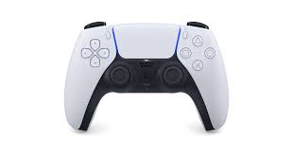
STRAFE R
STRAFE L
סיבוב
x,y

Slide 2
High chamber
Move arm(transfer/back)
Open/close Bclaw
Open/close Fclaw
High basket preset
Reset claw angle
Low basket preset
Climb preset
Low chamber preset
Open/close extendo
Lift up/down
Claw rotation
Click for reset slides

